Slide 1
Front End Engineering-I Project
Team Details:
Dhruv Kansal (2410993261)
Devyansh Aggarwal (2410993260)
3. Manthan Khatri (2410993291)
Faculty Coordinator: Ratan Lal Gupta
:
Chitkara University Institute of Engineering and Technology,
Chitkara University, Punjab

Slide 2
Table of Contents
Introduction
Problem Statement
Technical Details
Key Features
Project Highlights
Bonus Feature(optional)
Conclusion
References/Links used

Slide 3
Introduction
Personal Resume Page using:
Team Member:
1.Dhruv Kansal
2.Devyansh Aggarwal
3.Manthan Khatri`
Purpose: To create a resume builder website that simplify the resume creation process and help users to create professional, job-ready resumes efficiently.
GOALS:
Provide an easy-to-use platform with customizable templates to quickly create professional resumes.
Ensure resumes are ATS-friendly and tailored for specific roles or industries.
Offer personalization options and seamless downloading in various formats.
Provide pre-built content, examples, and tools to make resume-building fast and efficient.

Slide 4
Problem Statement
Our website solves common problems like time-consuming resume creation, lack of design and formatting skills, and ensuring ATS optimization. It provides pre-designed templates, guided prompts, and the ability to quickly customize resumes, helping users create professional, modern, and tailored resumes with ease.

Slide 5
Technical Details
HTML (Hyper Text Markup Language):
Defines the structure of the website.
Used to create elements like the input bar, buttons, and website interfaces.
CSS (Cascading Style Sheets):
Adds styling to the website to enhance visual appearance.
Provides layout design, color schemes, fonts, and responsive elements.
JavaScript:
Used in backend of the website.
Frameworks like React, Vue.js for building a dynamic and interactive user interface, enabling real-time updates and state management.

Slide 6
Key Features
User-Friendly Interface:
Our intuitive and easy-to-navigate platform allows users to create professional resumes without needing prior design or technical skills.
Customizable Templates:
Choose from a variety of modern, industry-specific templates that can be easily customized to fit your unique style and professional needs.
Download and Share Options:
Easily download your resume in multiple formats (PDF, Word) or share it directly with employers or on job platforms.
Mobile-Friendly:
Build or edit your resume on-the-go with our mobile-optimized platform, making it convenient to update your resume anytime, anywhere.

Slide 7
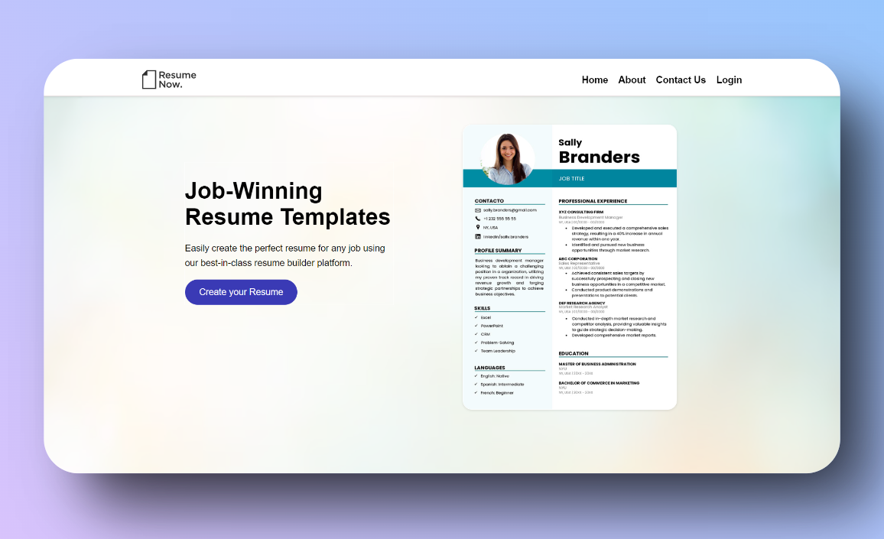
Project Highlights

Slide 8
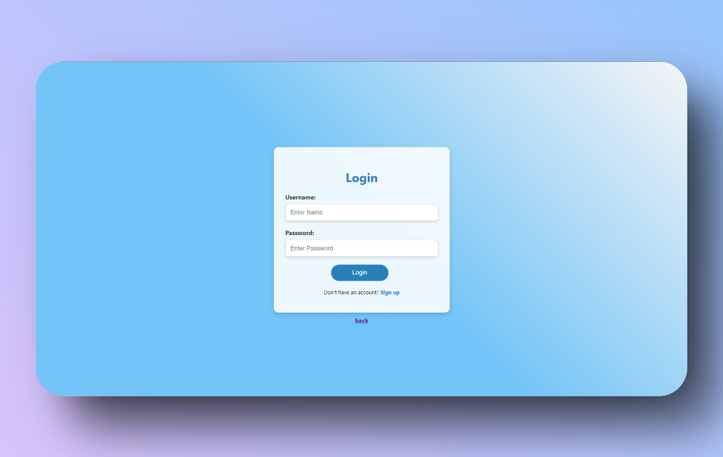
Project Highlights

Slide 9
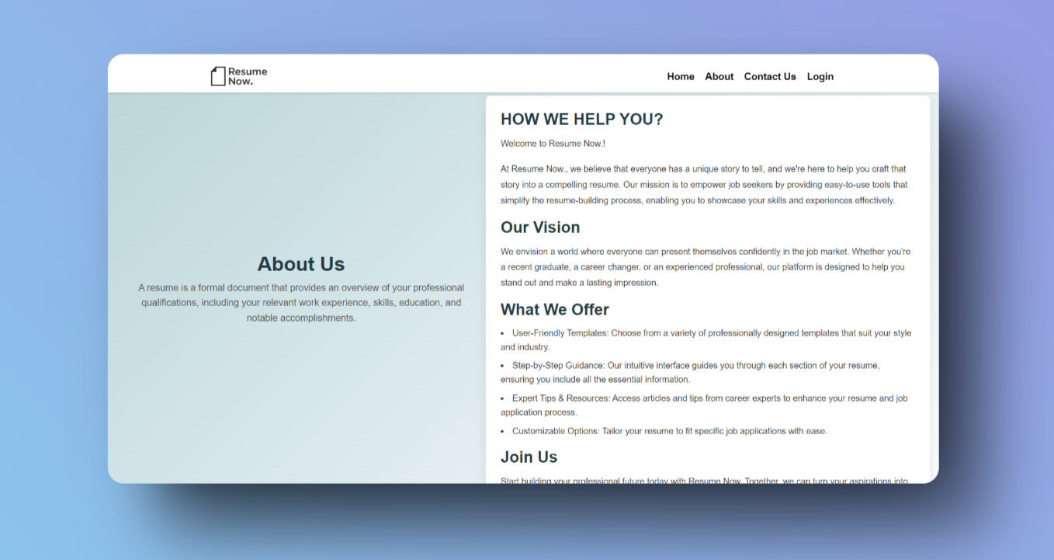
Project Highlights

Slide 10
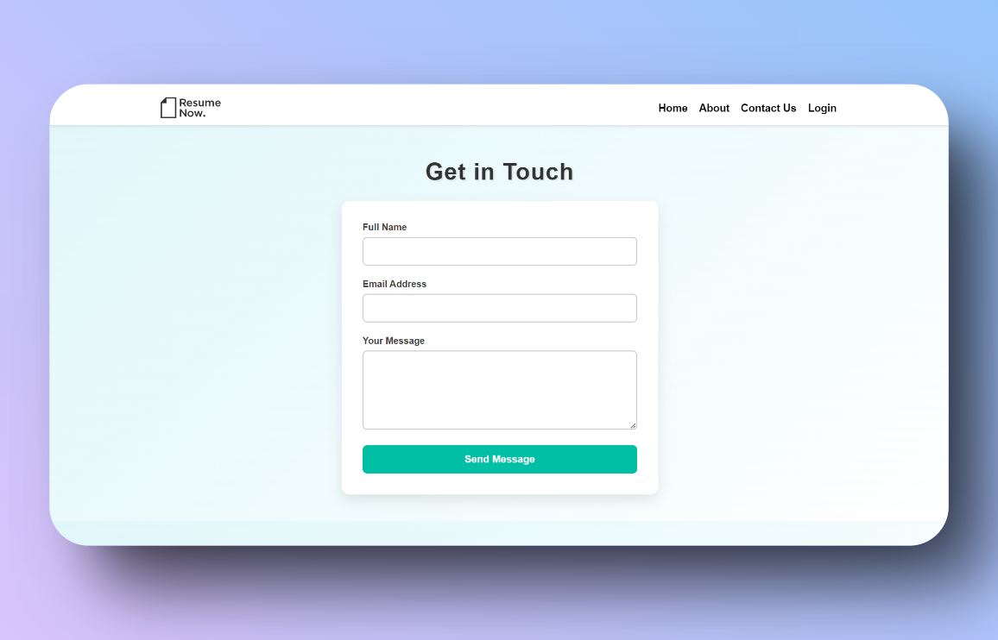
Project Highlights

Slide 11
Conclusion
Summary:
Our Resume builder website successfully addresses the need by building Professional Resume by leveraging modern web technologies like HTML, CSS, and JavaScript.
Our website offers a seamless and user-friendly experience, empowering job seekers to create professional resumes in minutes.
Team’s Key Takeaways:
Collaboration & Problem Solving:
Working as a team taught us how to collaborate effectively, delegate tasks, and solve problems together, especially in integrating APIs and handling errors.
Hands-On Technical Experience:
Strengthened our understanding of web development technologies (HTML, CSS, JavaScript).
Importance of User Experience:
Gained valuable insights into designing user-friendly interfaces, emphasizing simplicity and clarity to enhance user satisfaction.
Adapting to New Challenges:
Learned how to adapt to technical challenges, including responsive design and ensuring the website functions smoothly across different devices.

Slide 12
References/Links used
https://www.w3schools.com/html/default.asp
https://developer.mozilla.org/en-US/docs/Web/CSS

Slide 13


